Slide 1
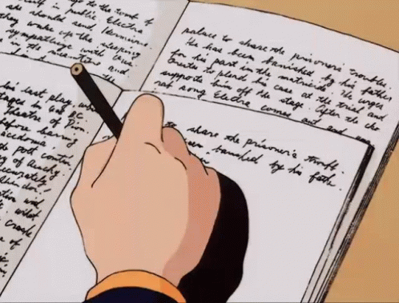
15/04/2026
George Hardwick
How to:
Teach Writing for the C1 Exam

Slide 2

Agenda
Introduction
Part 1: Essay [Organisation, Content]
Part 2: Other text types Communicative Achievement, Language]

Slide 3

Introductions
Discuss with your partner(s):
What experience do you have of teaching:
C1-level learners / Writing / The CAE exam ?

Slide 4

Pop Quiz!
ANSWERS
Two.
Essay (Part 1, mandatory);
Letter or email / Proposal / Review / Report (Part 2, choose between the three)
220 - 260 words
Four: Content, Communicative Achievement, Organisation, Language
All equally! Each one is worth 5 marks out of 20 in total.
Work together to answer the questions.

Slide 5
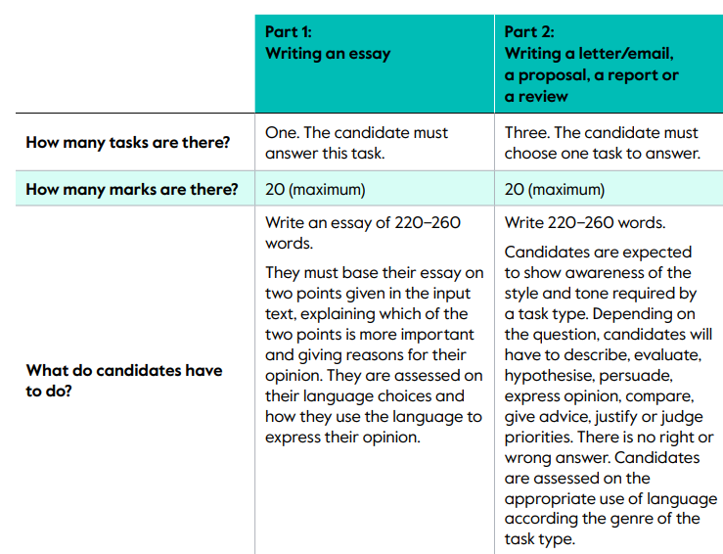
To clarify…

Slide 6
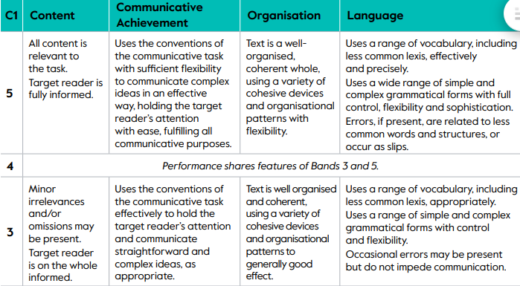
To clarify…

Slide 7
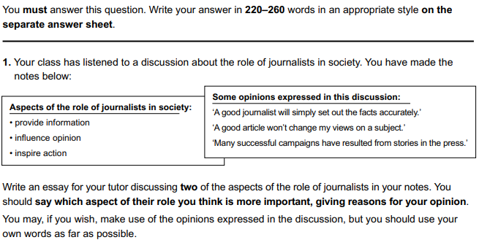
How to teach: Part 1: Essay
What are some key features of an essay?
Sample essay question:

Slide 8
Key Features: Essay
Text Type | Distinctive Features
Essay | Neutral – formal register Academic Examines both sides of an argument in a clearly organised structure; likely to come to a definite conclusion INTRODUCTION Body paragraph 1 Body paragraph 2 CONCLUSION

Slide 9
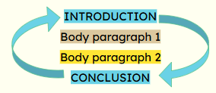
Activity: Planning
⇒ With your partner(s), write a plan for this essay.
Don’t worry, I’m not going to make you actually write it!
Use this checklist
Introduction:
State your stance/opinion Body paragraph 1
Topic sentence
Explanation
Supporting example
Body paragraph 2:
Topic sentence
Explanation
Supporting example
Conclusion:
Restate the stance/opinion expressed in the introduction.
(2 sentences max.)

Slide 10
Reflection
Is this planning task useful for students to do in class? Why?
This task can help your students to better meet the assessment criteria:
Organisation & Content.
If they can do this really well, that’s potentially 50% of their writing marks achieved regardless of how good their grammar/vocabulary/spelling is!

Slide 11
Part 2 [Choice of Texts)
⇒ Study the sample texts from Part 2 of the exam and answer the questions.
Sample texts adapted from Complete Advanced 3rd edition,Greg Archer, Guy Brook-Hart, Sue Elliot, Simon Haines. Cambridge University Press.

Slide 12
Reflection
A textual analysis task like this can help raise learners’ awareness of the features/character of the different text types, and compare and contrast them.
This type of exercise helps students focus on the Communicative Achievement and Language criteria.

Slide 13
Key Takeaways?
All 4 criteria are equally important and can be taught- let’s not focus only on grammar and word choice/spelling, but on the way sentences/paragraphs connect, the register of the whole text, etc…
Students need to understand the features of the types of text required before they can write them effectively.

